Slide 1

Financial Education for High School Students
State Bar of Texas
Bankruptcy Law Section

Slide 2
Real World Situations
There are situations you will face in the next few years that can impact your financial future for many years to come.
College / Employment
Student Loans
Living within a Budget
Renting an Apartment
Buying a Home
Credit Cards
Saving for the Future
Smart decisions
Now will give you more options for the future.

Slide 3

What matters to you?
What are some things you value most now and what will you value later?
Home
Car
Clothes
Food
Cell Phone / Entertainment

Slide 4

Reaching Your Goals
How do you get these things you value?
MONEY!
MONEY!
MONEY!

Slide 5
Budget
BUDGET – The Ugliest Word You’ll Ever Love!
Average Salaries in the U.S. :
Administrative Assistant
$31,640 per year
Mechanic
$37,990 per year
Nurse
$64,670 per year
Teacher
$52,270 per year
Attorney
$130,850 per year
Doctor
$168,010 per year

Slide 6
Budget
Gross vs. Net Income :
Gross Income – The amount you make before taxes are taken out of your paycheck.
Net Income – The amount you make after taxes and deductions. (Also called “Take-Home Pay”)
TIP: Focus on the net income for your budget!

Slide 7
Budget
Expenses:
How much do you think you’ll spend per month after high school or college?
Let’s look at an example budget.
What are possible unexpected expenses?

Slide 8
Budget
THREE TIPS FOR SUCCESS:
Pay your bills on time or early.
Keep good records.
Set aside time to review your budget.

Slide 9
Managing Your Money
Checking Accounts - Four Tips:
Choose the best bank account for you.
Balance your bank account.
- Keep track of what you spend!
Only spend an amount you actually have in your account.
- And watch for bank fees and ATM charges!
Keep an eye on check/debit cards – They are easy to use, easy to abuse.

Slide 10
Managing Your Money
Saving Accounts and Investments:
Tip: Saving money, even just a little, is paying yourself first. The habit of saving is more important than the amount you save!
Most employers offer 401K Retirement Accounts to which you may contribute monthly.
If your employer doesn’t offer a 401K, you may still invest in an individual Retirement Account, or IRA.

Slide 11
Managing Your Money
$400,000
$350,000
$300,000
$250,000
$200,000
$150,000
$100,000
$50,000
$0
“$250 per month savings contribution for 40 years at 5% interest.
Total investment is $120,000, with a return of $400,000.”

Slide 12
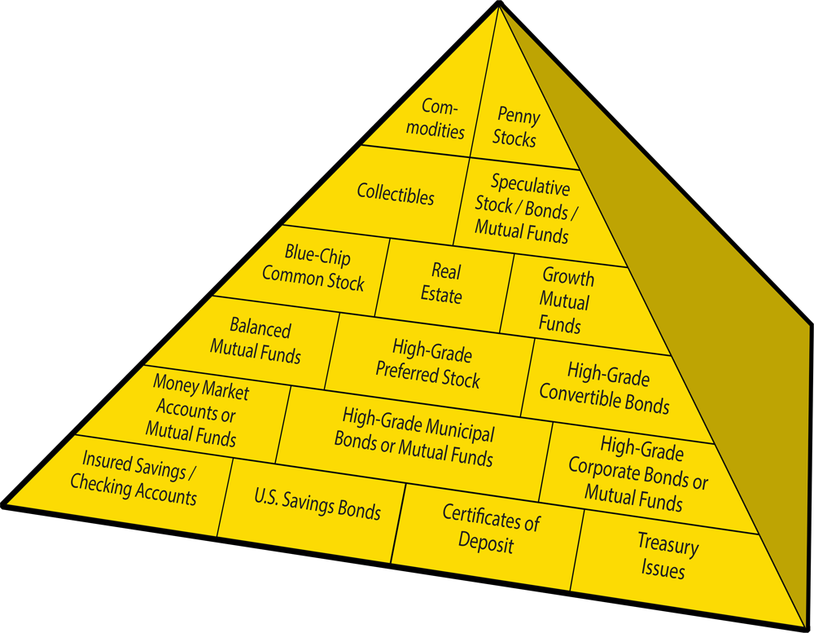
Financial Planning Pyramid
Highest Risk – Highest Earnings
Lowest Risk – Lower Earnings

Slide 13
Reaching Your Goals
Saving money and paying cash is the best way to purchase items you may need or want.
How do you start saving to reach you financial goal?
Four Step Planning Process:
Assess you Needs
Set Goals
Make a Plan
Take Action

Slide 14
Credit
CREDIT CARDS:
Enjoy paying bills? Sign on for life!!!
What is credit? – Credit is a service that lets you buy something now and pay for it later.
Tip: Remember, CREDIT CARDS = DEBT.

Slide 15
Credit
Credit is easy to get, easy to abuse!
Credit Costs:
Interest rates on purchases, from 12% to 29.99%
The length of time given to repay the debt
Tip: Don’t go overboard with credit!

Slide 16
Credit
Minimum Payment Blues -
Compare how long it takes to pay off credit card debts by making the minimum payment each month
Making the Minimum Monthly Payment (4% of the balance owed or $20, whichever is greater):
Credit Amount
APR
Years to Pay Off
Total Interest Paid
Total Paid
$2500
21%
40 years, 8 months
$11,894
$14,394
Making Payment of $100 per Month
Credit Amount
APR
Years to Pay Off
Total Interest Paid
Total Paid
$2500
21%
3 years
$906
$3,406

Slide 17
Credit
Other Ways to Pay, a.k.a. ‘Creative Accounting’
Say you want to purchase a television for $500. How much will you actually pay when you purchase it different ways?
Financing Options | Sales Price | Payoff Period (Months) | Monthly Payment | Total Paid | Interest Paid | Effective Interest Rate
Cash | $500.00 | 0 | $0.00 | $500.00 | $0.00 | 0%
Layaway | $500.00 | 3 | $166.67 | $500.00 | $0.00 | 0%
Credit Card | $500.00 | 24 | $25.00 | $600.00 | $100.00 | 20%
Rent to Own | $500.00 | 24 | $50.00 | $1,200.00 | $700.00 | 140%

Slide 18
Credit
Interest Rates on Other Types of Loans:
Bank Loan – up to 10% per year
Pawn Shop Loans – up to 240% per year
Payday Loans – up to 400% per year
Credit Card Cash Advance Loans – up to 600% per year
TIP: READ THE FINE PRINT!!!

Slide 19
Types of Debt
So what secured debt could I incur?
Buying a car –
Watch the interest rates on car loans, and read the contract.
If you don’t make payments, your car could be repossessed!
Buying a home –
Use the SMART plan to save money for a down payment on the home you plan to buy.
Keep an eye on interest rates; certain types of mortgages can be bad news.
Try to pay more principal debt owed each month. This will help you earn equity in your home.
If you stop making mortgage payments, your house could be placed in foreclosure!

Slide 20
Interest Rate Savings Comparison Chart
2011 Chevrolet Camaro 3.6L V6
2011 Chevrolet Camaro 3.6L V6
Price
$23,530.00
Price
$23,530.00
Down Payment
-$2,500.00
Down Payment
-$2,500.00
Amount Financed
$21,030.00
Amount Financed
$21,030.00
Interest Rate
6.41%
Loan Period: | 60 Months | 48 Months | 36 Months
Monthly Payments: | $410.59 | $497.85 | $643.69
Interest Over Term of Loan: | $3,605.40 | $2,866.80 | $2,142.84
Sum of all Payments: | $24,635.40 | $23,896.80 | $23,172.84
Interest Savings (60 v. 48 Months): |  | $738.60
Interest Savings (60 v. 36 Months): |  |  | $1,462.56
Interest Rate | 3.90% | 6.41% | 14%
Loan Period: | 60 Months | 60 Months | 60 Months
Monthly Payments: | $386.35 | $410.59 | $489.33
Interest Over Term of Loan: | $2,151.00 | $3,605.40 | $8,329.80
Sum of all Payments: | $23,181.00 | $21,635.40 | $29,359.80
Interest Savings (3.9% v. 6.41%): |  | $1,454.40
Interest Savings (3.9% v. 14%): |  |  | $6,178.80

Slide 21
Types of Debt
So what unsecured debt could I incur?
Renting an apartment –
Remember to include the deposit amount, rent payment, and utility expensed when preparing your budget.
Credit cards –
Watch the interest rate on credit cards.
Medical bills –
Look for jobs with insurance benefits.
Student loans –
Take advantage of grants, scholarships and work-study programs to minimize student loan debt.

Slide 22
Credit Reports
Bad credit reports are like bad report cards…no fun!!!
It’s reviewed by lenders, landlords, potential employers, insurance agencies, utility companies…
It may contain someone else’s information.
It may contain false/mistaken information/
Most negative information can affect credit for up to seven years or more!
TIP: Just like forest fires, only YOU can prevent false information on your credit report!!!

Slide 23
Bankruptcy
Bankruptcy is a way to handle debts once you’re overcome with bills, and can’t pay those debts with monthly payments.
Bankruptcy can negatively affect your credit rating for up to ten years, causing it to be difficult to get credit in the future.
TIP: Bankruptcy should be viewed as a last resort!

Slide 24
Be Money Wise
REMEMBER:
Be wary of co-signing for debt for another person.
If you take on more debt than you can handle, you could lose the property or face a lawsuit.
By using the tools we have discussed today, you can avoid having too much debt, and achieve financial success!

Slide 25
GOOD LUCK!
We wish you the best of luck in whatever you do, and we wish you
GREAT FINANCIAL SUCCESS!!!

